Slide 1

Review –IV presentation on
FairTestPro :- New testing platform where no one can cheat.
Submitted to the Savitribai phule pune university ,pune
In the partial fulfilment of the requirements for the award of degree of
Bachelor of engineering (computer engineering)
Submitted by
Name of Student:
1.Chinmay Inamdar
2. Abhijeet Phute
3.Komal Gandal
4.Tejal Kamthe
Guide Prof. : Prof. Mulani K. S
DEPARTMENT OF COMPUTER ENGINEERING
STE’S Sinhgad institute of technology, Lonavala
SAVITRIBAI PHULE PUNE UNIVERSITY
Academic Year-2024-25

Slide 2
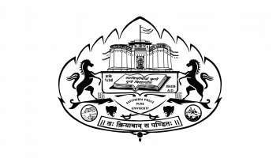
Introduction
FairTestPro aims to prevent impersonation, detect unauthorized persons, and monitor suspicious behaviors in real-time.
This platform not only ensures a fair testing experience but also promotes academic honesty and integrity in educational assessments.

Slide 3
Proposed system
FairTestPro is a cutting-edge web-based testing platform designed to create a secure and cheat-proof examination environment.

Slide 4
Objective of project:
Enhancing Examination Integrity:
Utilize advanced machine learning models for face detection to verify examinee identity.
Continuously monitor for unauthorized persons using object detection models.
Using advance tab change detection system prevent user to change the tab.
Authentication of the candidate using valid govt. id and candidate’s live photo
Objectives of Project

Slide 5
Functional Requirements:-
User Authentication
Cheating Detection
Automated Proctoring
Result Calculation
Non-Functional Requirements:-
Scalability
Security
Performance
Requirement Identified

Slide 6
Feasibility:-
Technical Feasibility:- The project is technically feasible because it will leverage proven technologies like machine learning algorithms and proven web based frameworks.
Economic Feasibility:- The project is economically feasible, as it will reduce the costs of human monitoring.
Operational Feasibility:- The project is operationally feasible, as the platform will be designed to be user-friendly. Both students and examiners can easily interact.
Scope:-
Develop a fully functional online exam platform with basic proctoring and cheating prevention.
Feasibility and Scope of project

Slide 7
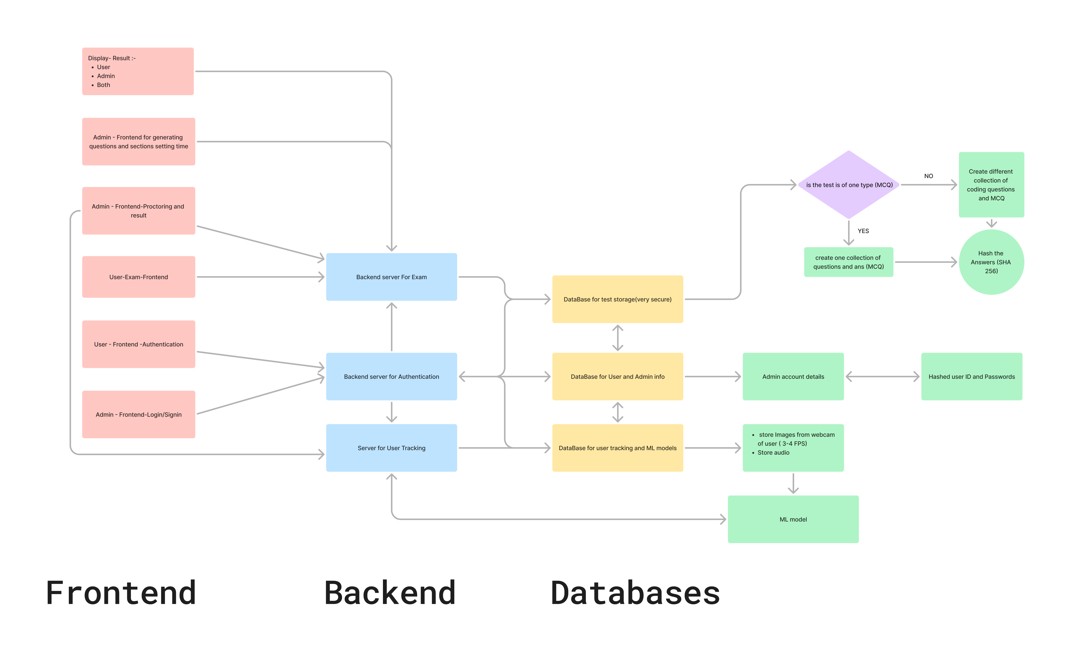
System
Architecture

Slide 8
Algorithms Used
Lightweight Head Pose Estimation Model
Face Verification-Dlib's ResNet50 CNN model
Face Spoofing Detection-Scikit-learn’s ExtraTreesClassifier

Slide 9
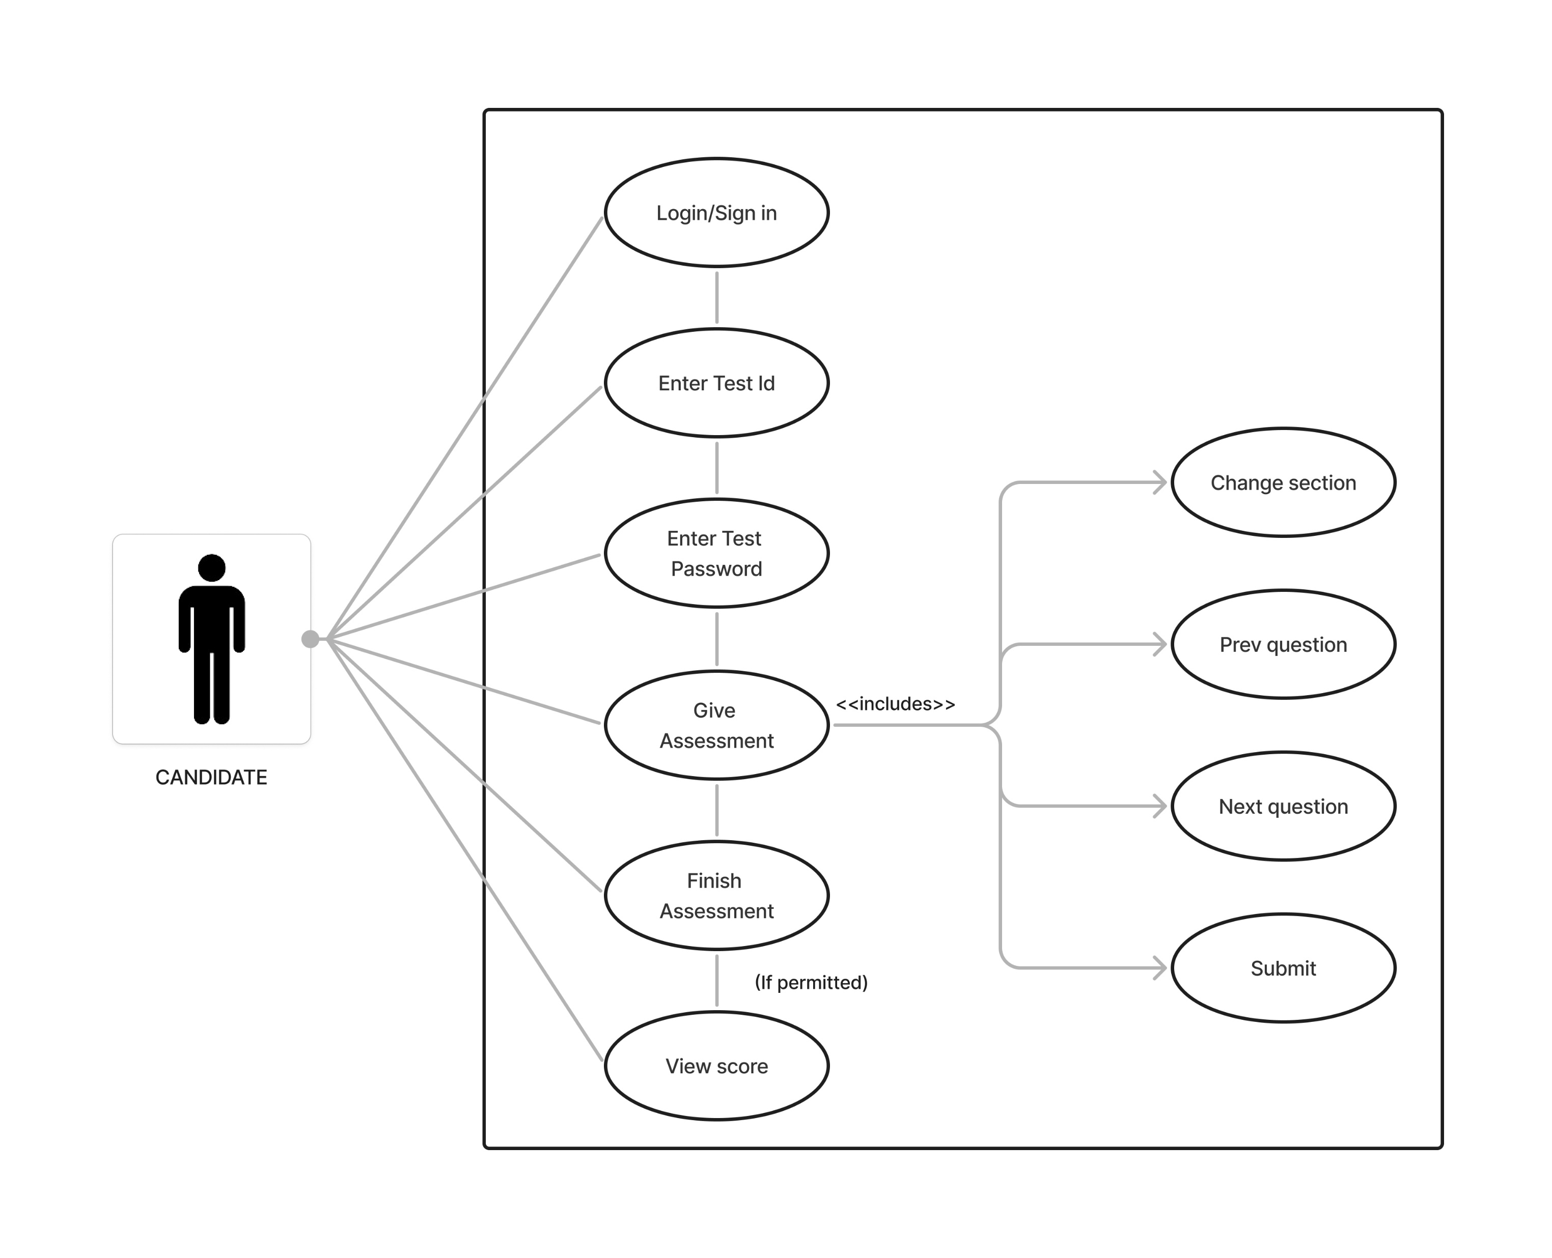
Use Case Diagram
Actor: Candidate

Slide 10
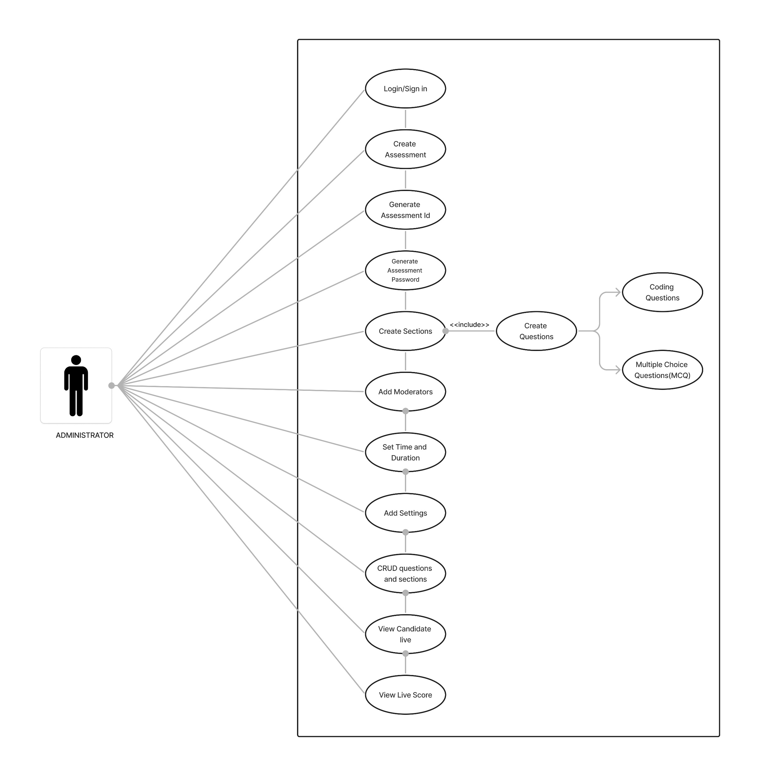
Use Case Diagram
Actor: Administrator

Slide 11
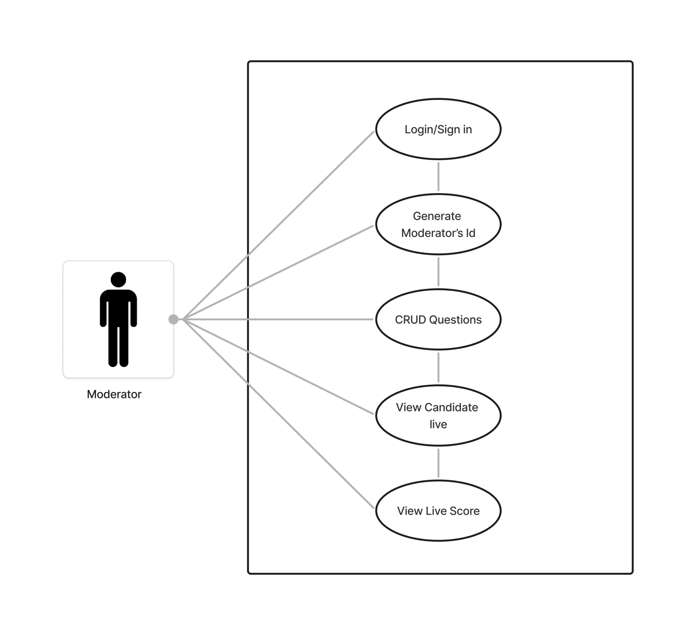
Use Case Diagram
Actor: Moderator

Slide 12
Risks Identified:-
Internet Connectivity Issues
Privacy and Data Security
False Positives in Cheating Detection
Hardware Incompatibility
Backup plan:-
Multiple Attempts for Reconnects
Manual Review System
Risk Identified and Backup plan

Slide 13
Advantages
Increased Accessibility
Automation and Efficiency
Advanced Cheating Prevention
Real-Time Monitoring
Multi-Factor Authentication

Slide 14
Disadvantages
Technical Glitches
False Alarms

Slide 15
Limitations
Latency and Real-Time Processing
Inaccurate Detection

Slide 16
Application of Proposed system
Promotes Academic Integrity:-
Helps maintain fairness in educational assessments, ensuring that grades and certifications reflect true knowledge and skills.
Reduces Cheating and Dishonesty:-
Discourages dishonest practices in online exams, fostering a culture of honesty and accountability
Prepares Society for Digital Transformation:-
Supports the shift towards remote learning and working by providing secure and effective online assessment solutions

Slide 17
Conclusion
FairTestPro is designed to make online exams secure and cheat-proof. By using advanced technology to verify identities, detect unauthorized people, monitor eye movements, and spot electronic devices, it ensures a fair testing environment.

Slide 18
References
[1] “An Intelligent System For Online Exam Monitoring” Swathi Prathish, Athi Narayanan S, Kamal Bijlani.
[2] “Detecting cheating in electronic exams using the artificial intelligence approach” Bashar H. Asker Ahmad F. Al-allaf.
[3] “Cheating Detection in Browser-based Online Exams through Eye Gaze Tracking” Nimesha Dilini, Asara Senaratne, Tharindu Yasarathna Nalin Warnajith, Leelanga Seneviratne.
[4] “Online Exam Proctoring System using ML” Mrs. Peddaboina Yamuna , Purra Vivek Reddy, Katare Sai Praneeth, Uppunuthula Akhil, Siga Chandu.

